Slide 1
CSE321: Operating Systems
Introduction
FBA

Slide 2
Course Outcome
To understand the fundamental concepts of computer system organization and the structure of operating systems.
To explore various aspects of process management in operating system
To know how different CPU scheduling algorithm works and their respective importance
To develop practical knowledge on the concept of threads
To inspect process synchronization mechanisms and deadlocks
To be able to analyze the management of main and virtual memory

Slide 3
Marks Distribution
Theory – 80%
Class participation – 5%
Take Home Exam – 5%
Quiz – 10% (n-1)
Mid – 25%
Final – 35%
Lab – 20%

Slide 4

Operating Systems
"Actual” Introduction
FBA

Slide 5
What is an Operating System?
A program that acts as an intermediary
between a user of a computer and the computer hardware.
USER Application
( a program or application or interface)
Operating System
( a system software )
Hardware
( processor, monitor, keyboard etc. )

Slide 6
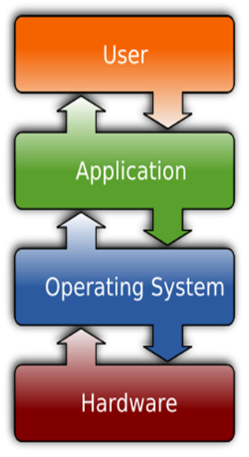
System Software Vs Application Software
System Software:
System Software refers to the operating system and all utility programs that manage computer resources at a low level.
Systems software includes compilers, loaders, linkers, and debuggers.
Application Software:
Applications software comprises programs designed for an end user, such as word processors, database systems, and spreadsheet programs.

Slide 7
Major Goals of OS
Execute user programs.
Make the computer system convenient to use.
Use the computer hardware in an efficient manner
Manages and allocate all resources
Controls the execution of user programs and operations of I/O devices

Slide 8
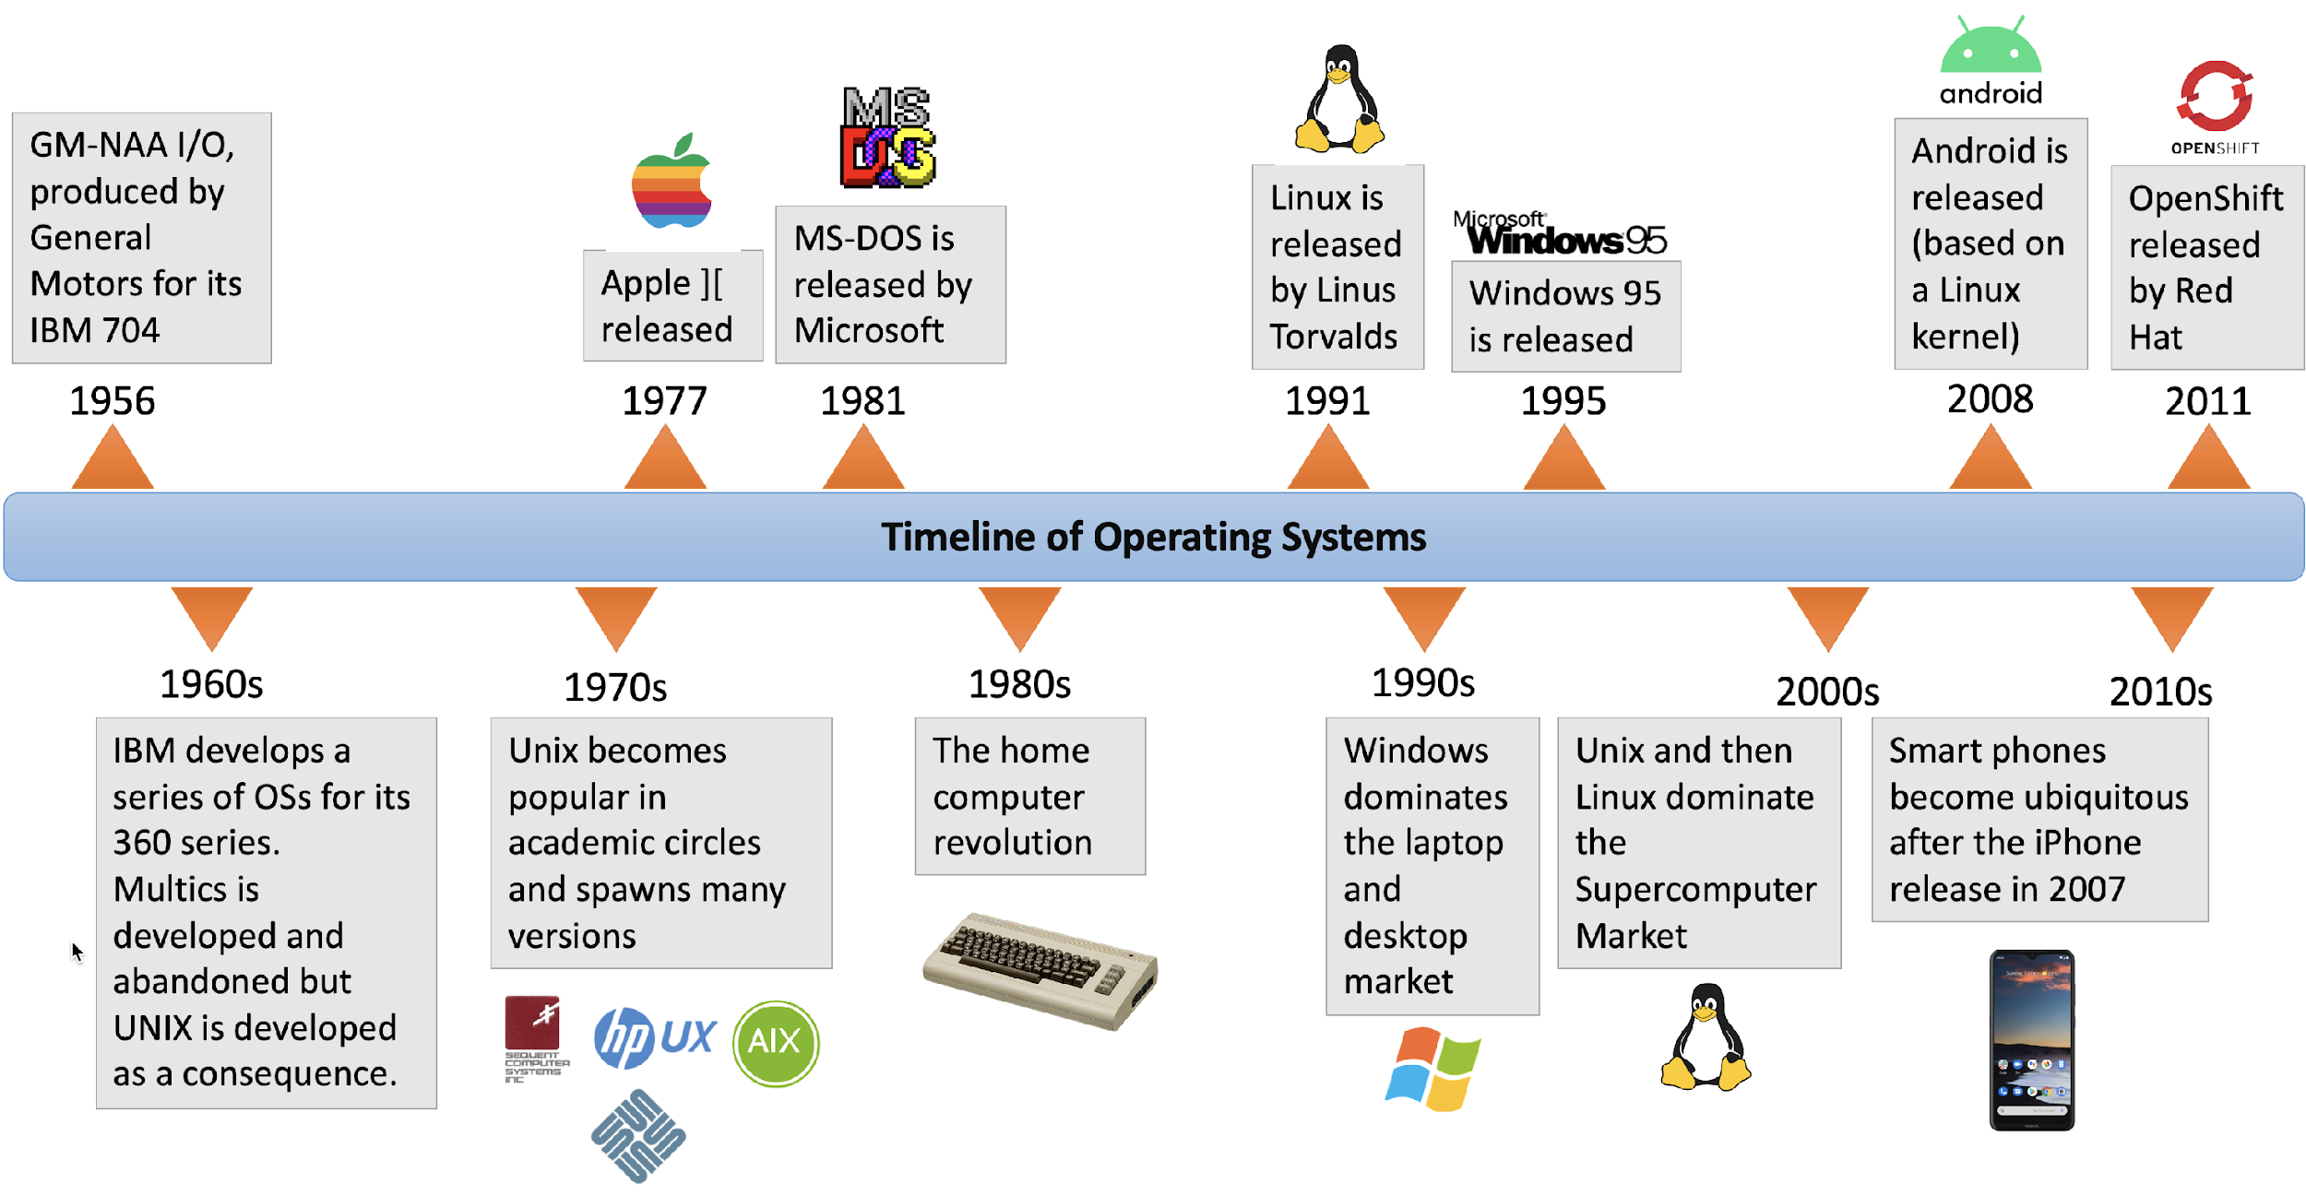
Timeline of OS

Slide 9

Timeline of OS

Slide 10
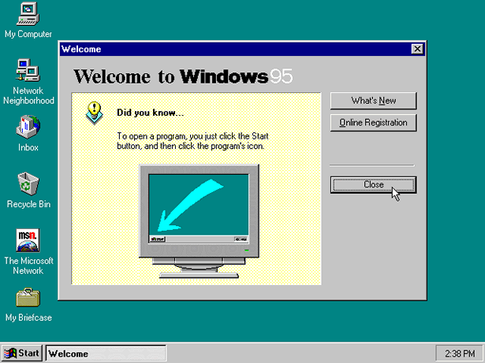
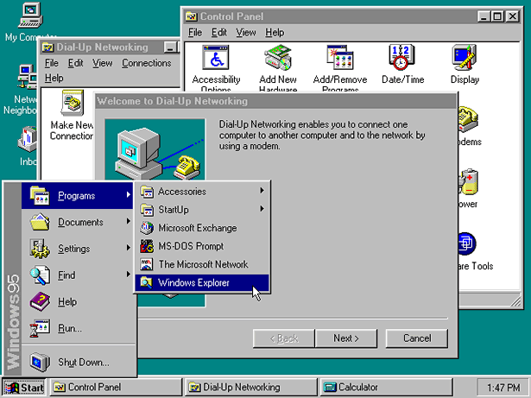
Timeline of OS

Slide 11
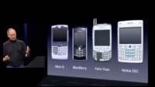
Timeline of OS
Another revolution of OS came in the mobile computing domain, when Steve Jobs introduced iPhone with iOS in 2007
The iPhone introduction video is now regarded as a classic advertise video

Slide 12
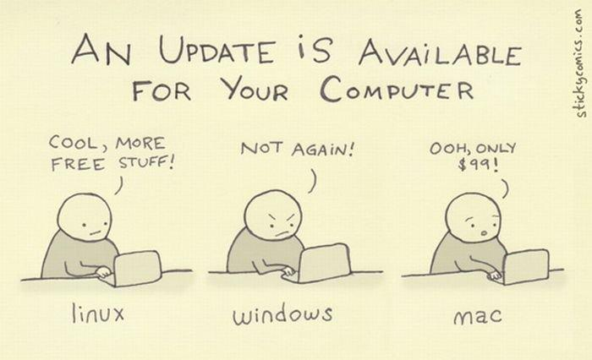

Slide 13
Operating Systems
Computer System Organization
FBA

Slide 14
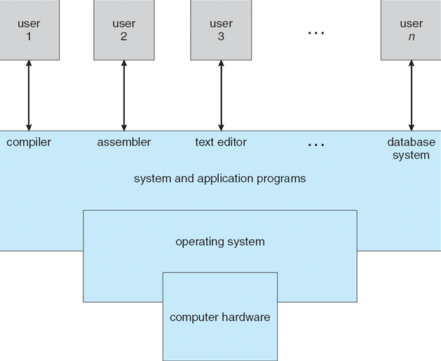
Components of a Computer System

Slide 15
Kernel
The one program running at all times.
Kernel is the central module of an operating system
Part of OS that loads first, and it remains in main memory.
As small as possible
Provide all the essential services required by other parts of the operating system and applications.
Kernel code is usually loaded into a protected area of memory to prevent it from being overwritten.

Slide 16
Bootstrap Program
An initial program executed when a computer starts running.
When a computers is powered up or rebooted, it is executed first.
Stored in the ROM or EEPROM, known as firmware
Initializes all aspects of the system, from CPU registers to device controllers to memory contents
bootstrap program must know how to load the operating system and how to start executing
Once the OS kernel is loaded and executing, it can start providing services to the system and its users

Slide 17
Storage Structure
Main memory – only large storage media that the CPU can access directly
Random access
Typically volatile
Secondary storage – extension of main memory that provides large nonvolatile storage capacity
CPU can load instructions only from main memory.
General-purpose computers run most of their programs from rewritable memory, called main memory ( also called RAM)
Computers use other forms of memory as well - Read Only Memory (ROM) and electrically erasable programmable read-only memory (EEPROM)
Only static programs, such as the bootstrap program described earlier, are stored here.

Slide 18
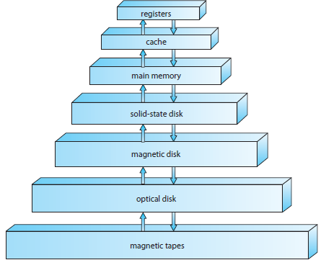
Storage Device Hierarchy

Slide 19
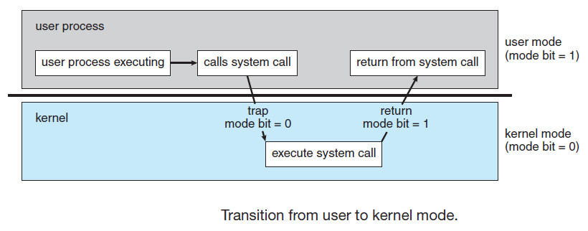
Dual Mode Operation
Need to distinguish between the execution of operating-system code and user defined code.
A bit, called the mode bit, is added to the hardware of the computer to indicate the current mode: kernel (0) or user (1).
dual mode of operation provides protection of the operating system from errant users
this protection is provided by designating some of the machine instructions that may cause harm as privileged instructions that are executed only in kernel mode.

Slide 20
Operating Systems
OS Architecture
FBA

Slide 21
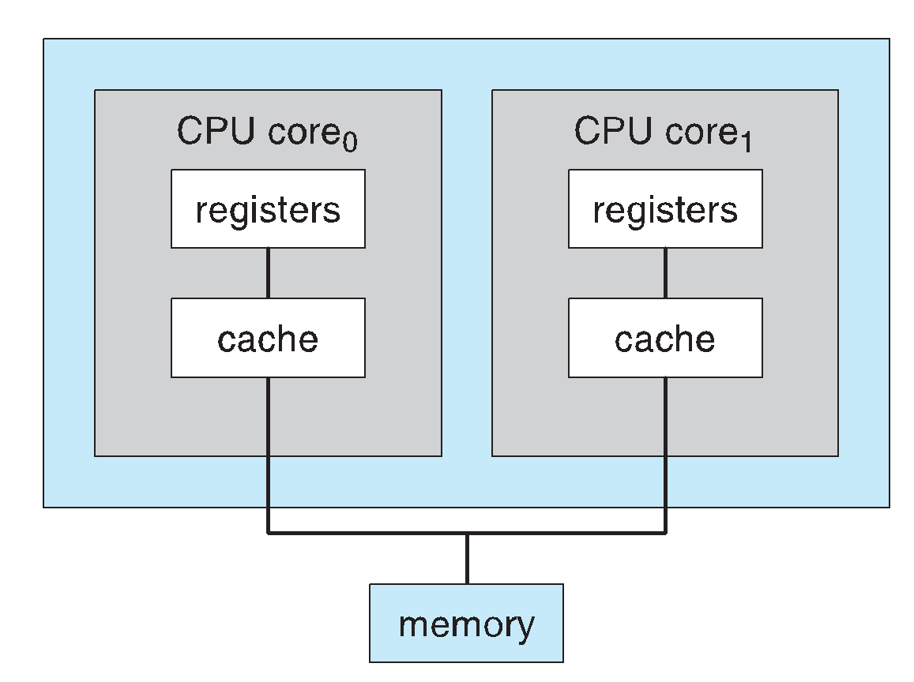
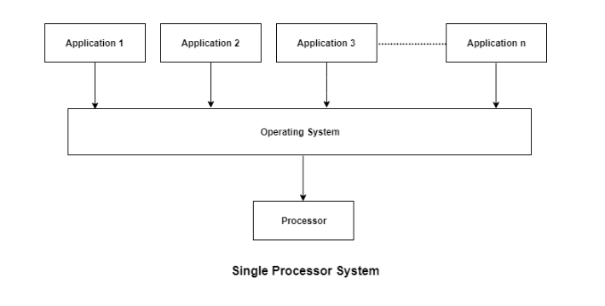
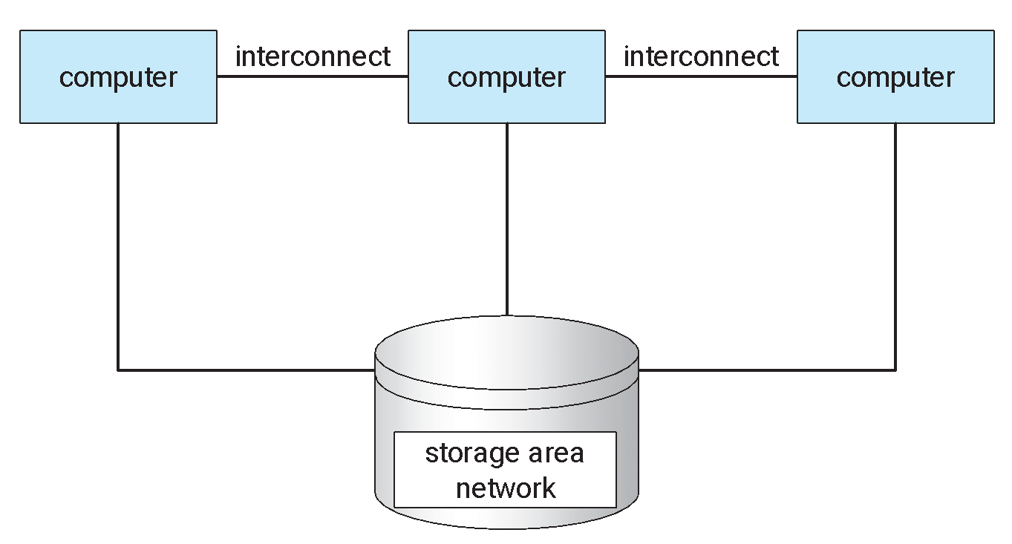
Operating System Architecture
Single-Processor Systems
Multiprocessor Systems
Clustered Systems

Slide 22
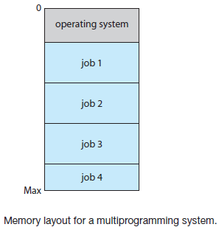
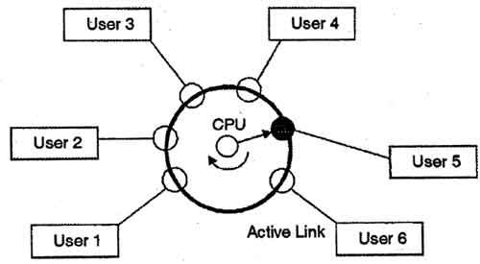
Operating System Architecture
Multiprogramming
Job Scheduling
CPU Scheduling
Time Sharing System

Slide 23
Operating Systems
OS Structure
FBA

Slide 24
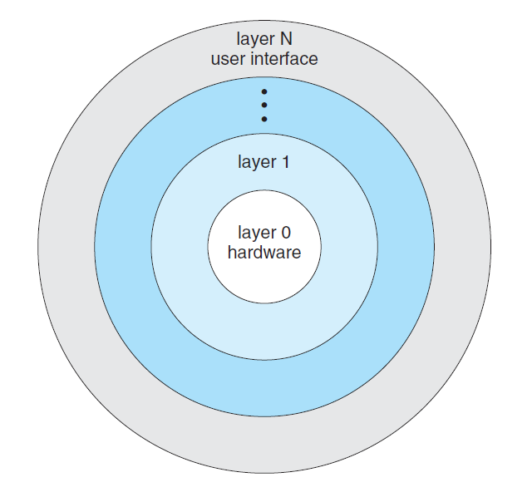
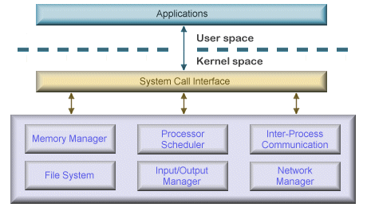
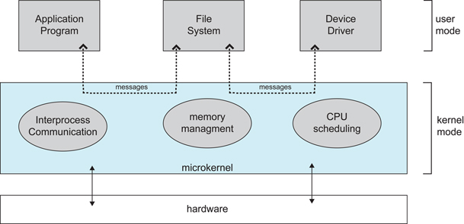
Operating System Structure
Simple/Monolithic structure
Layered structure
Microkernel structure

Slide 25
Operating Systems
OS Services
FBA

Slide 26
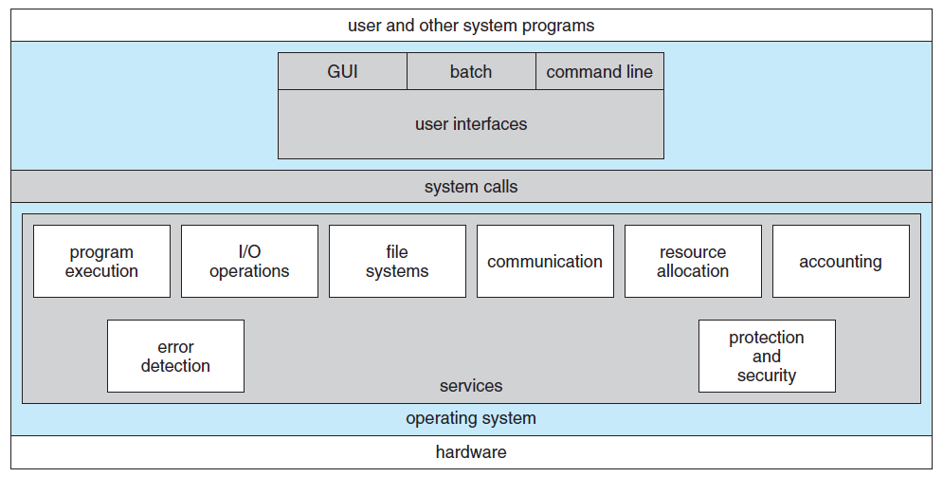
Operating System Services
OS provides an environment for the execution of programs.
Specific services provided, differ from one operating system to another, but there are some common classes
Services are provided for the convenience of the programmer

Slide 27
Operating Systems
System Call, System Program, System Boot
FBA

Slide 28
System Call
System calls provide an interface to the services made available by an operating system.
These calls are generally available as routines.
Routines are written in C or C++. Some low level tasks are written in assembly language.
A program to copy the contents of a file to another file !
Input two file name
Open the input file, and create the output file
Read from input file, and Write into output file
Close the file
Acquire input file name
Write prompt to screen
Accept input
Acquire output file name
Write prompt to screen
Accept input
Open the input file
if file doesn't exist, abort
Create output file
if file exists, abort
Loop
Read from input file
Write to output file
Until read fails
Close output file.
Write completion message to screen.
Terminate normally.
System Calls

Slide 29
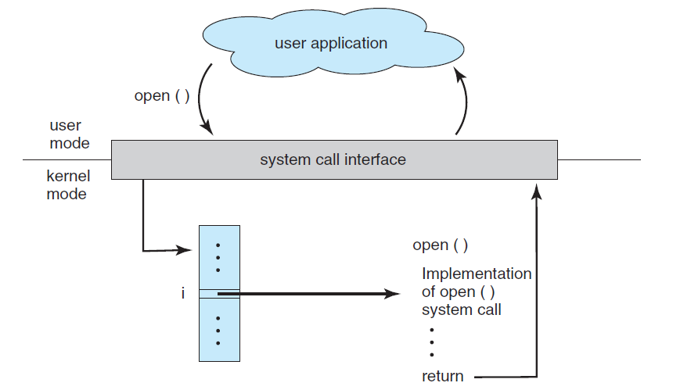
System Call Interface
Serves as the link to system calls made available by the operating system.
A number is associated with each system call, and the system-call interface maintains a table indexed according to these numbers.
Invokes the intended system call in the operating-system kernel and returns the status of the system call and any return values.

